Slide 1






MADelivery
Group n° 38
Ennio Riccobene
Simone Garofalo
Raffaele Martone
Francesco Guaiana

Slide 2
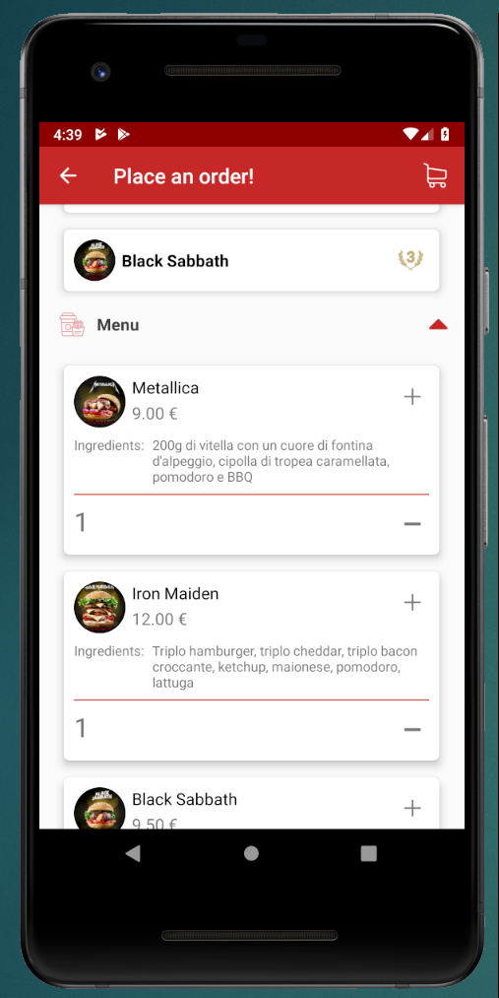
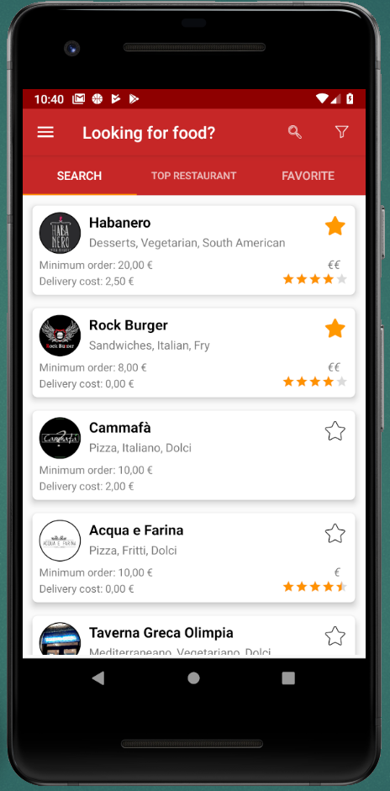
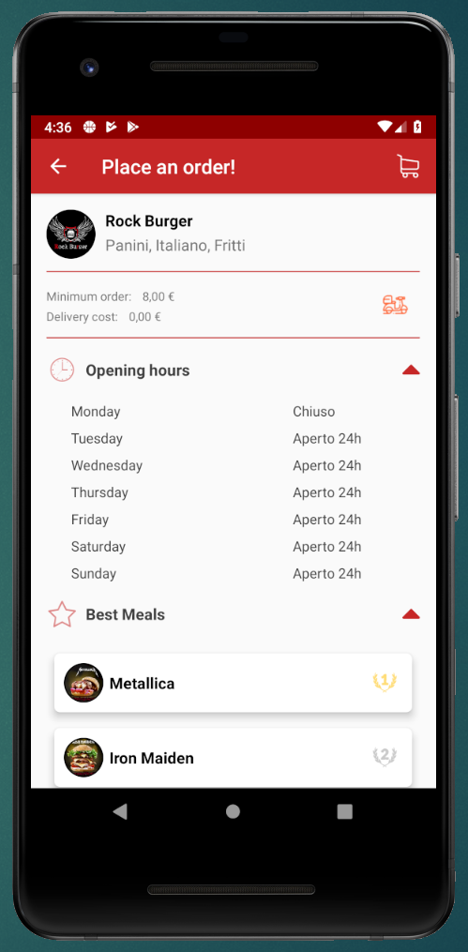
Attention to the customer
Order lifecycle
Place an order
Accept the order
Accept delivery
Preparing food
Call a Rider
Start navigation activity in App
Confirm receipt of order

Slide 3
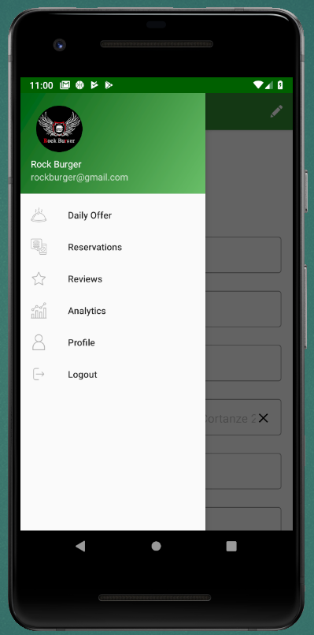
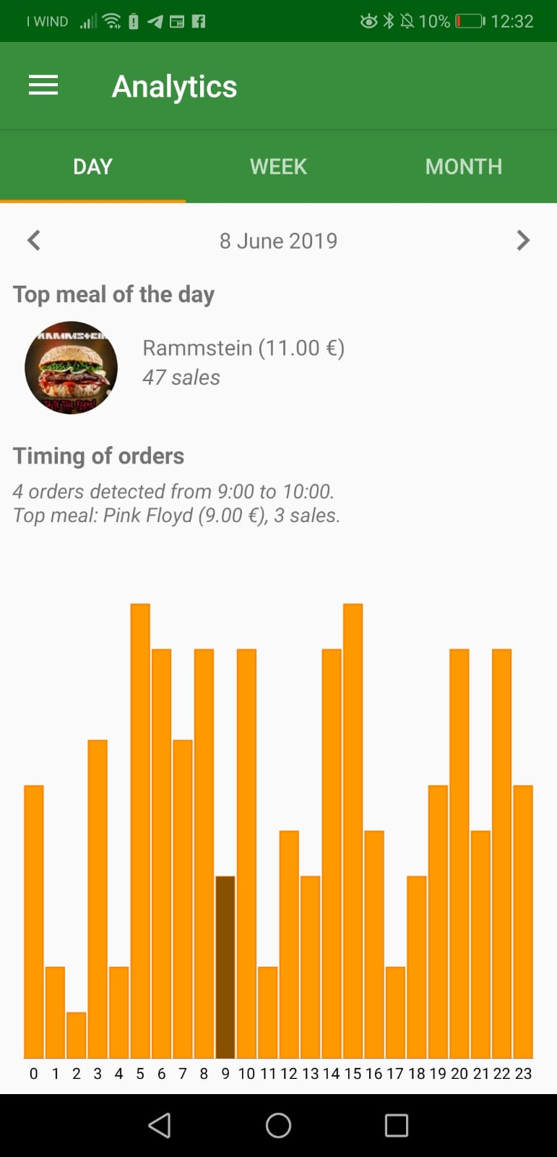
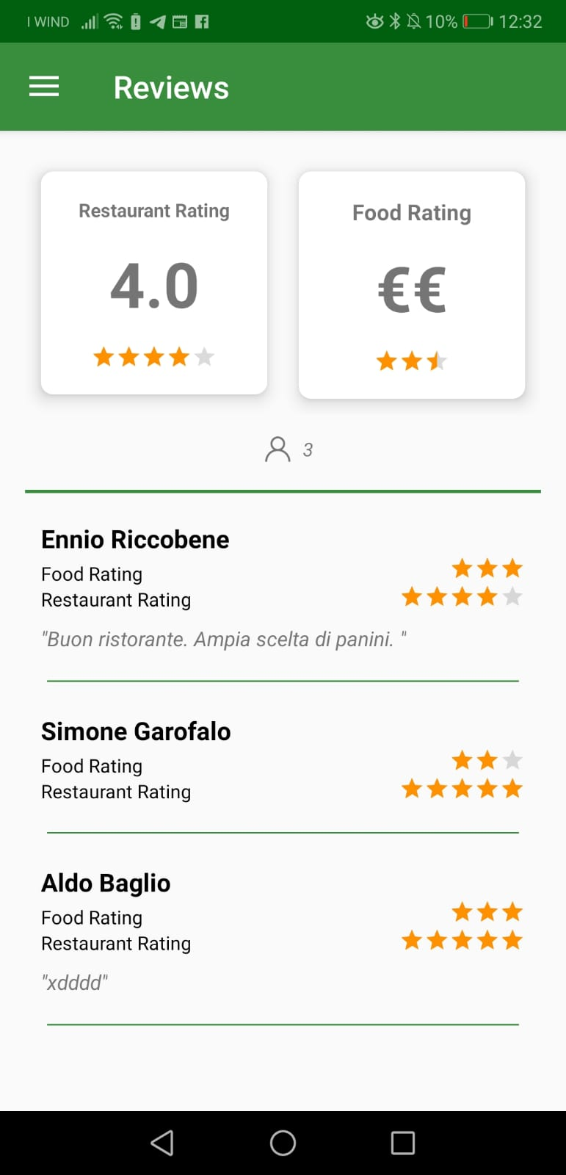
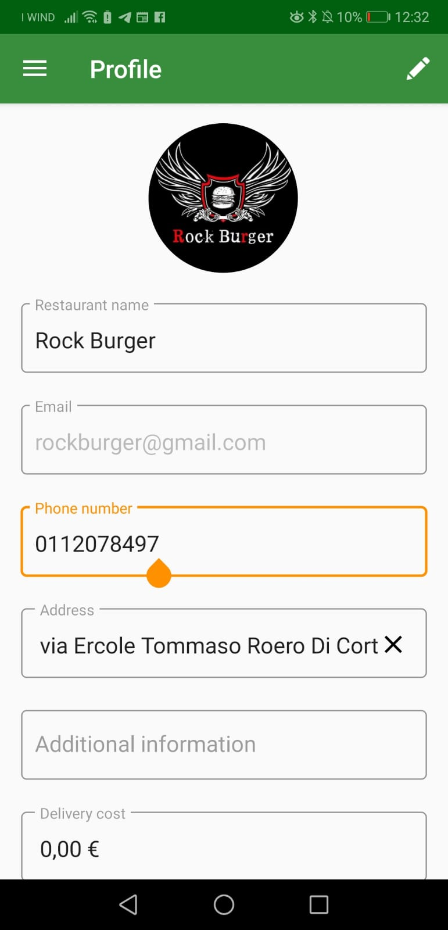
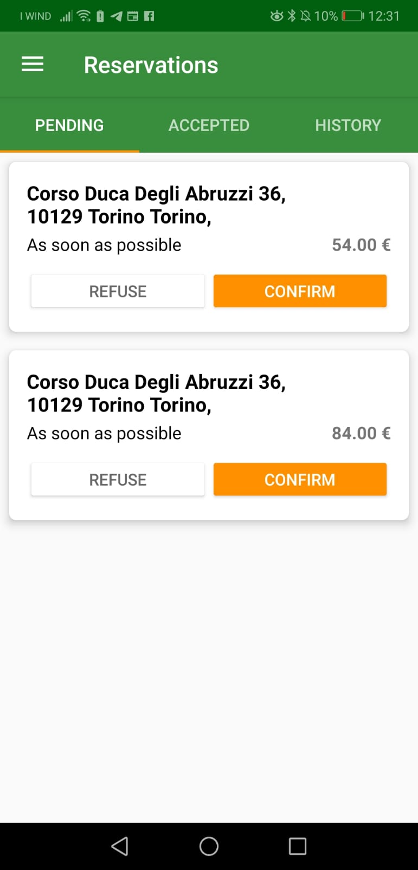
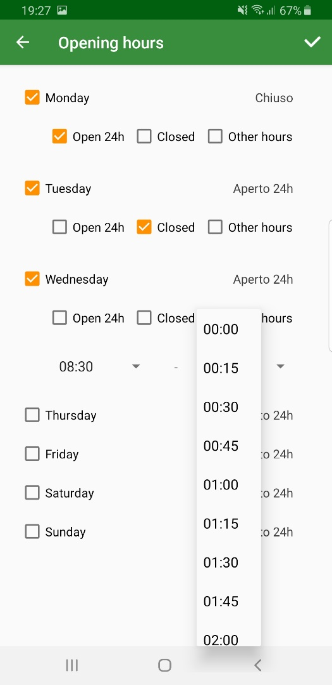
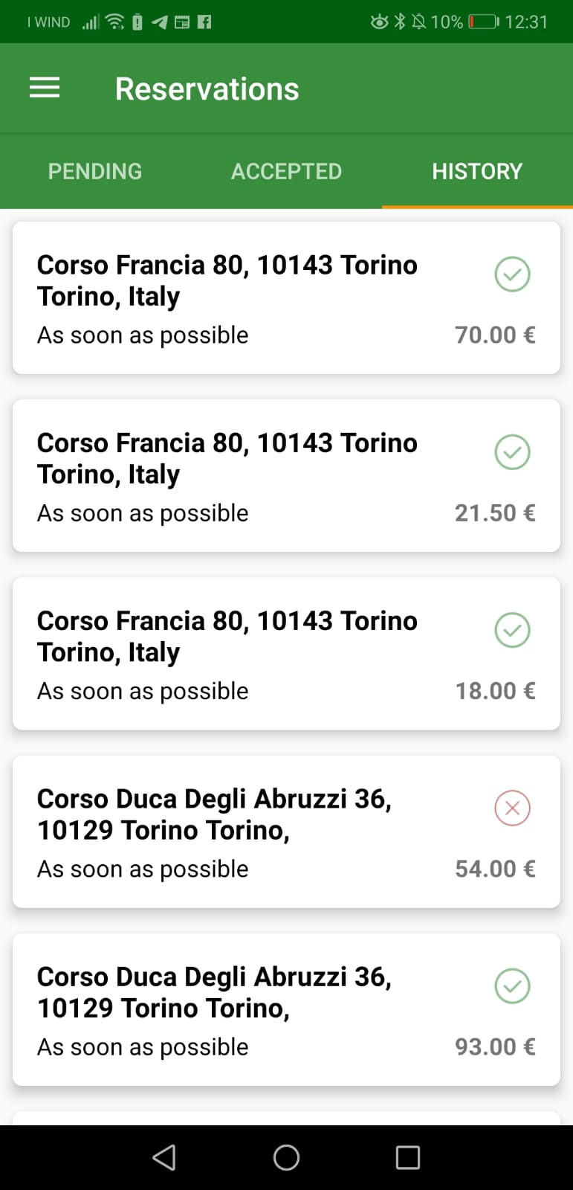
What about the Restaurant?
Place an order
Accept the order
Accept delivery
Preparing food
Call a Rider
Start navigation activity in App
Confirm receipt of order

Slide 4
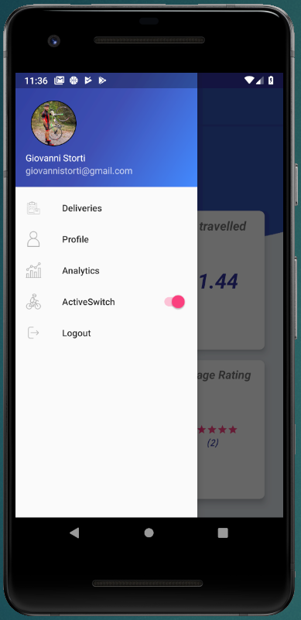
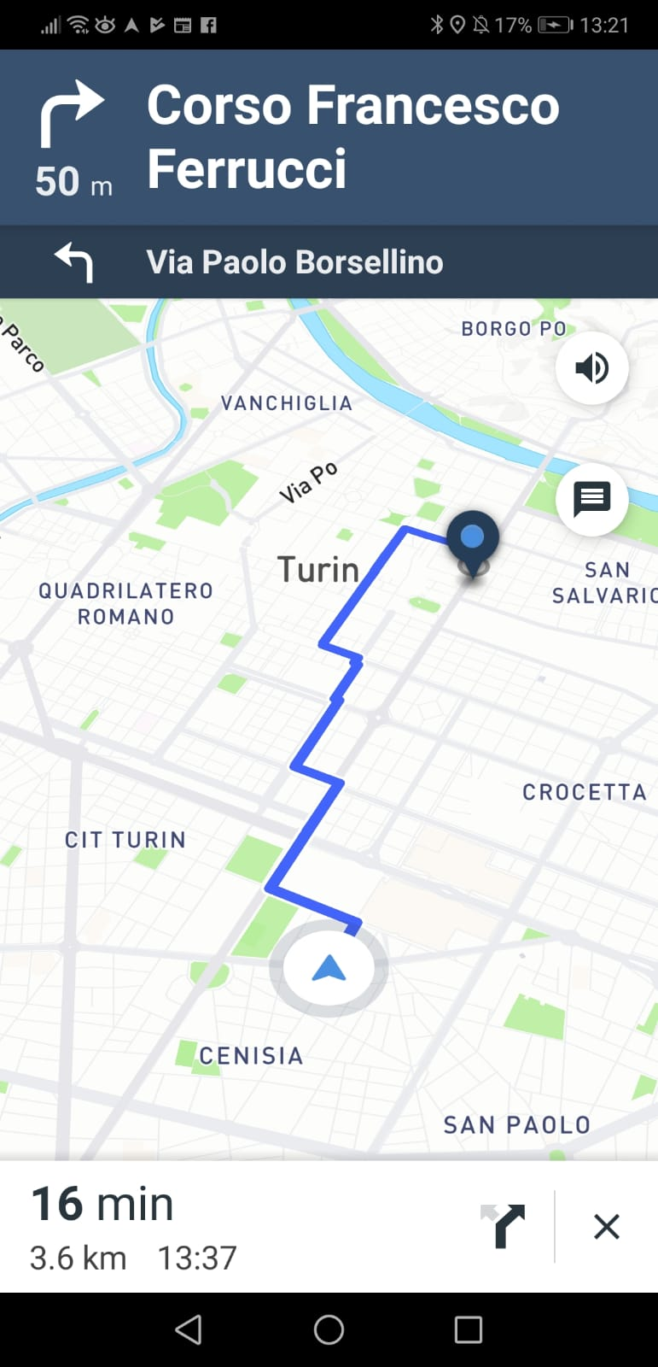
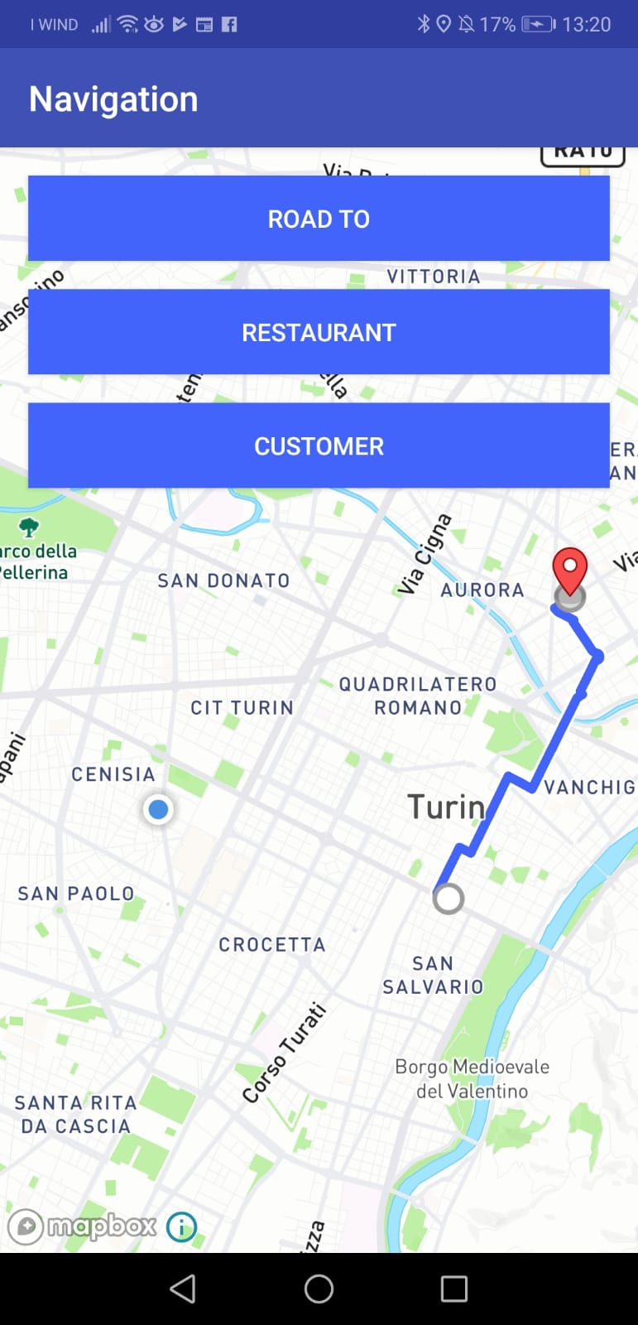
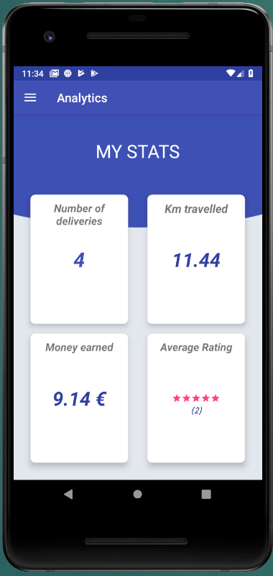
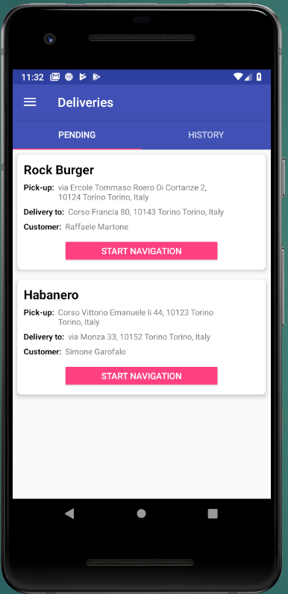
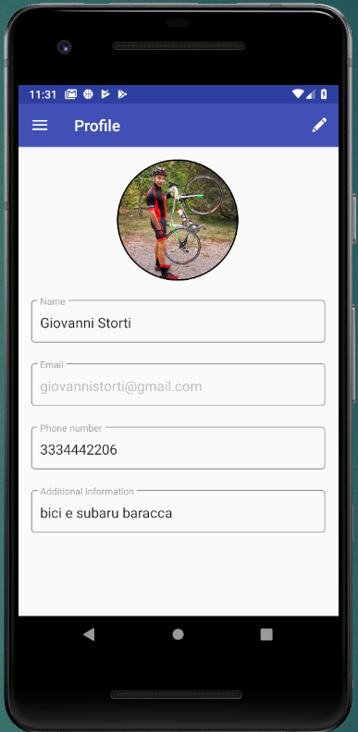
Biker Application
Place an order
Accept the order
Accept delivery
Preparing food
Call a Rider
Start navigation activity in App
Confirm receipt of order

Slide 5
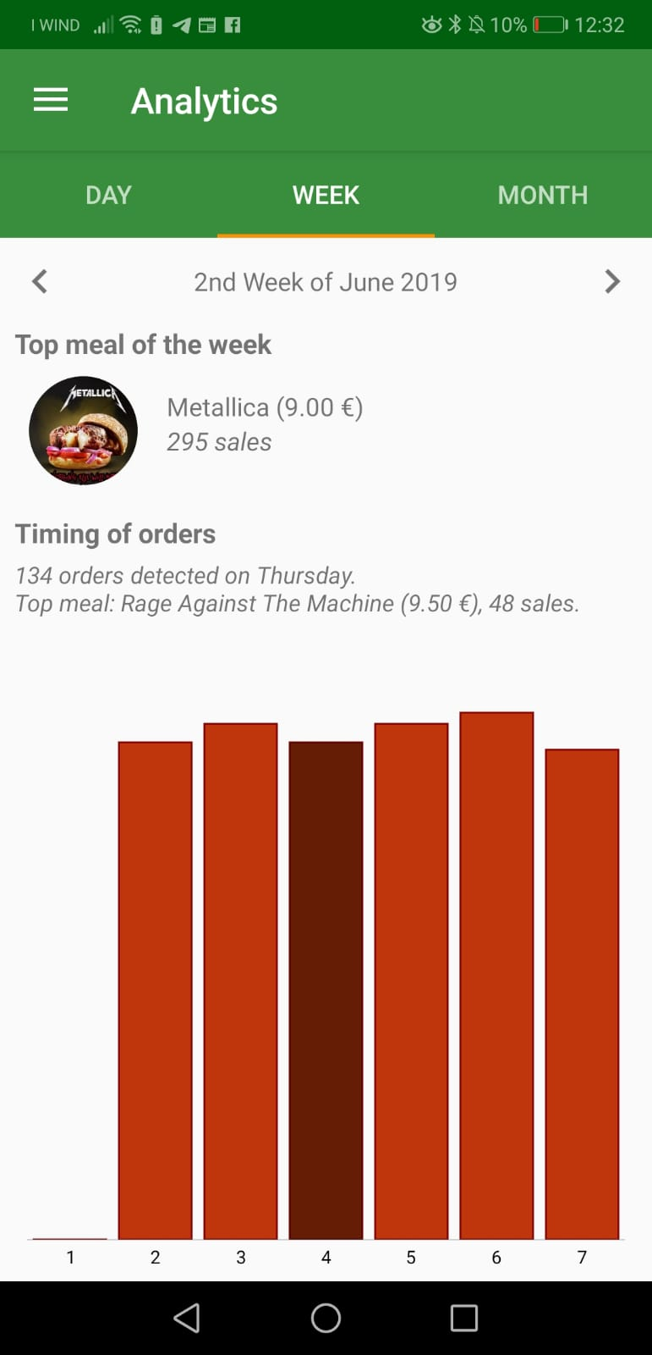
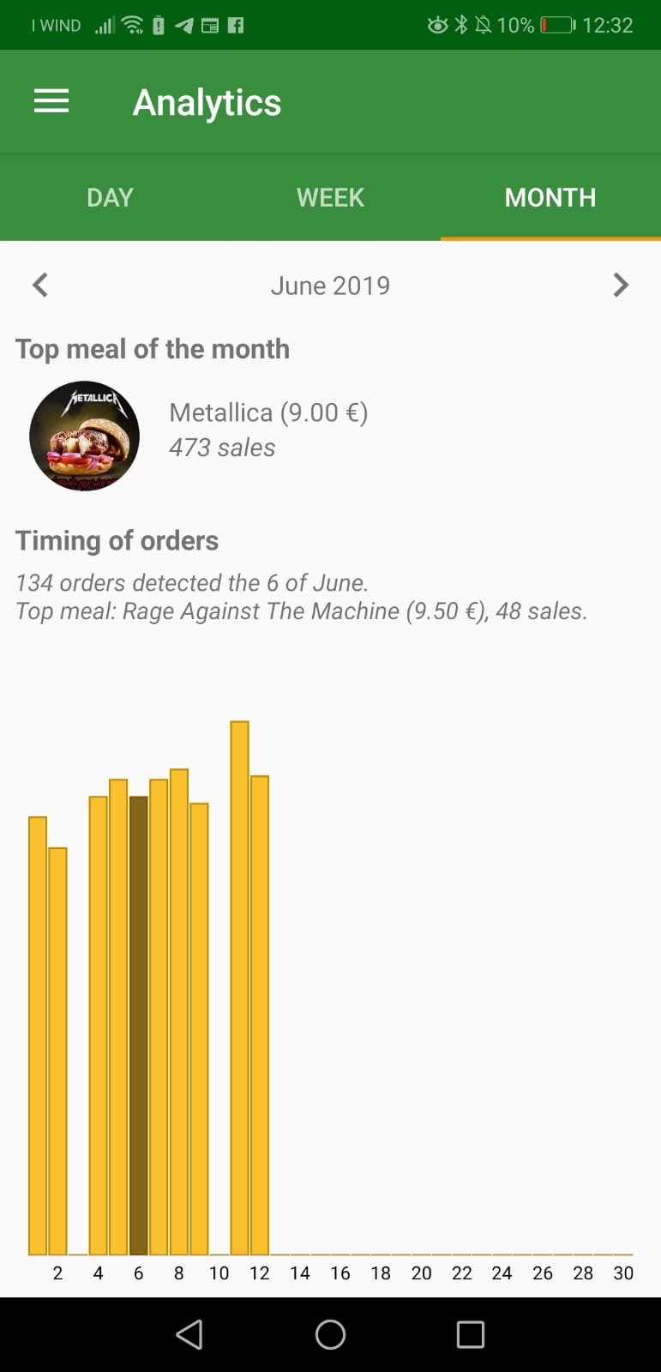
Analytics Pages Restaurant

Slide 6
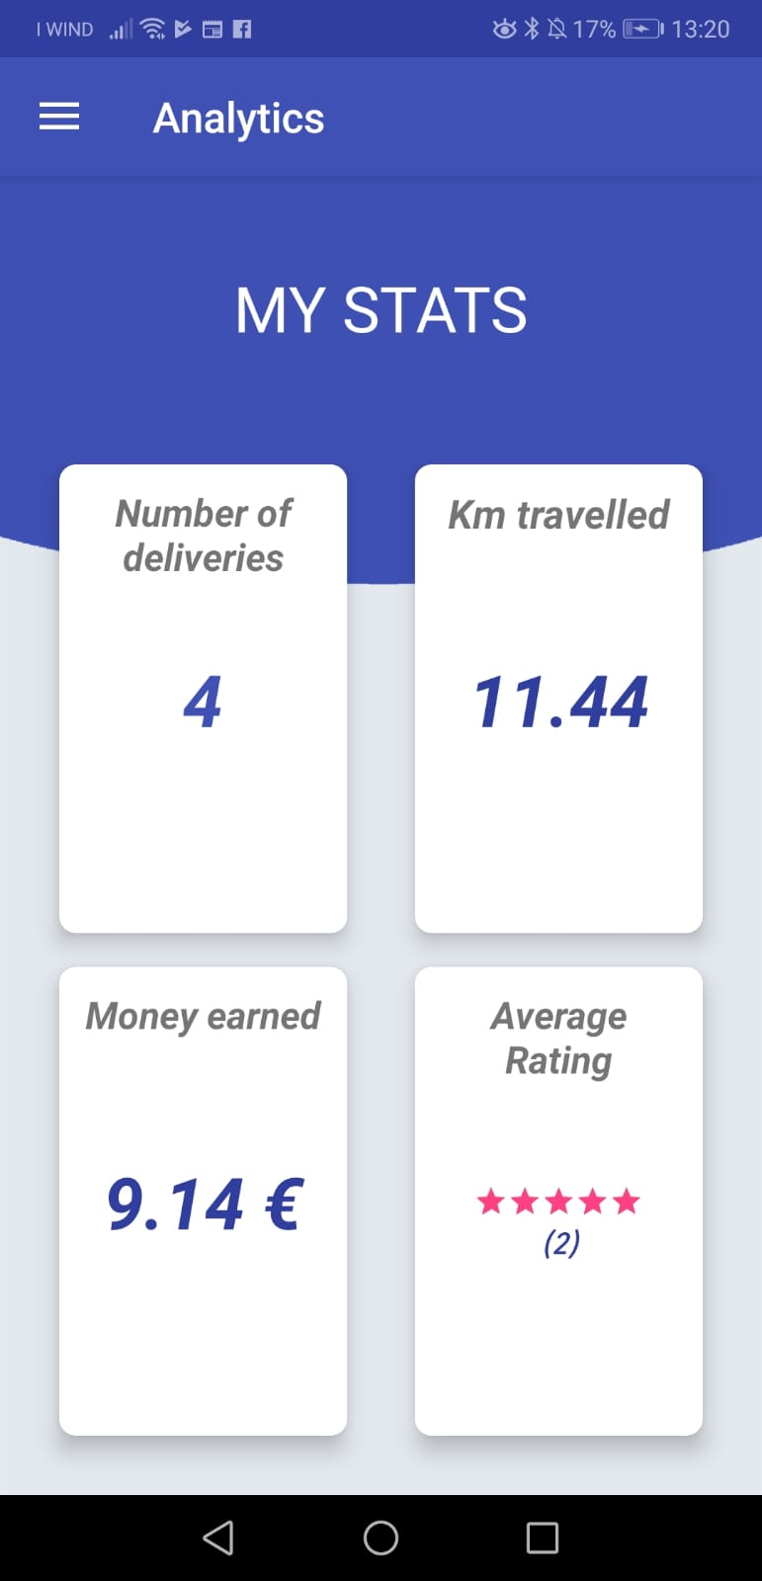
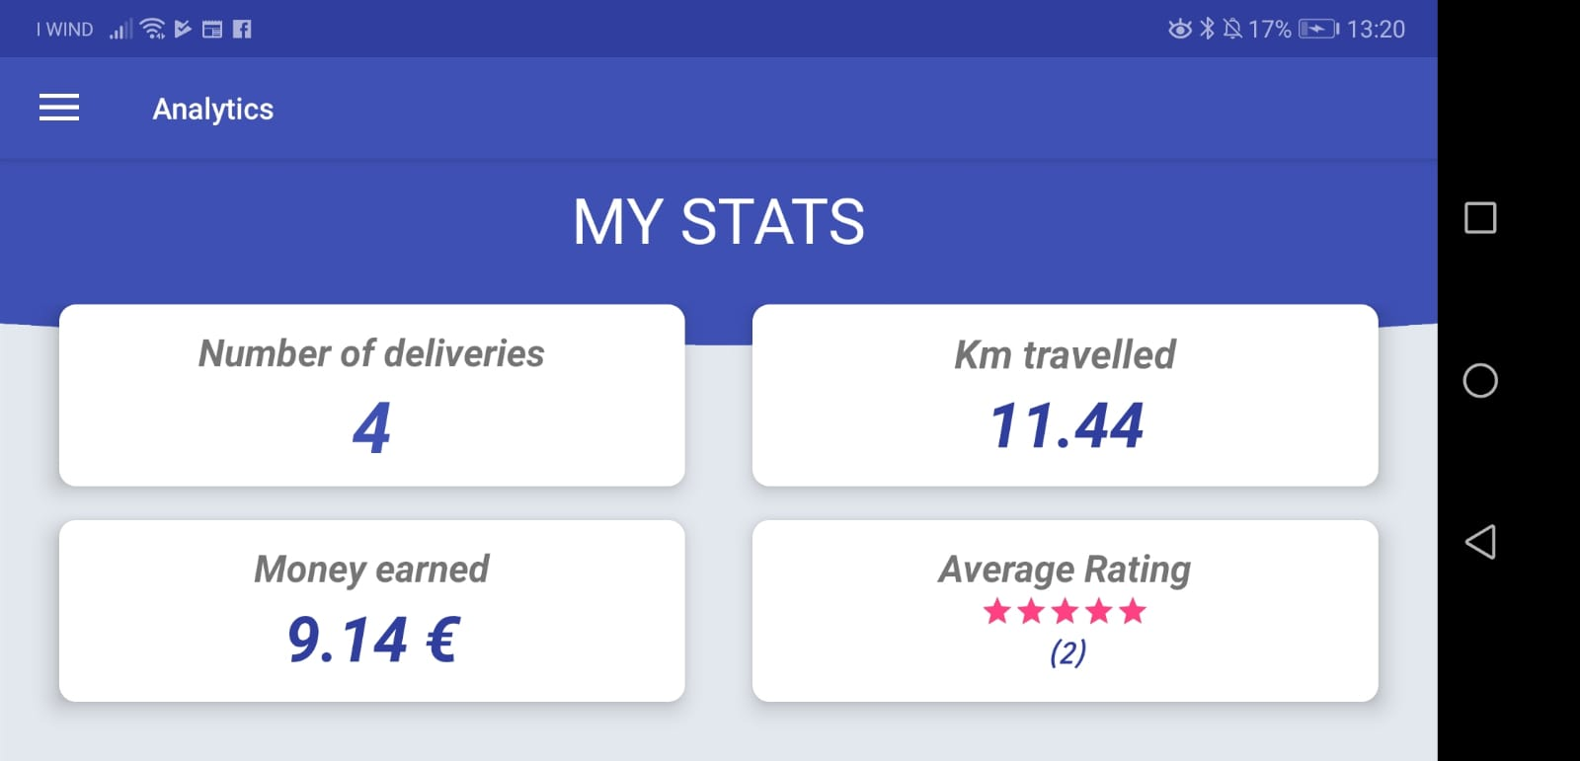

Analytics Page Biker
Competitors investigation

Slide 7
From MADelivery developers
Thank you for the
attention

